Slide 1
Papa Paolo
A worker placement driven game with tile
Lying, bidding and engine building mechanisms
interaction
Has been playtested for 2 years
2 - 4 players
Little downtime
Very enthusiastic reactions
60’
Easy to learn, lots of possibilities.

Slide 2
Goal?
Deliver as many pizza’s as possible!
Expand
Find sponsors & ingredients
Deliver pizza’s

Slide 3
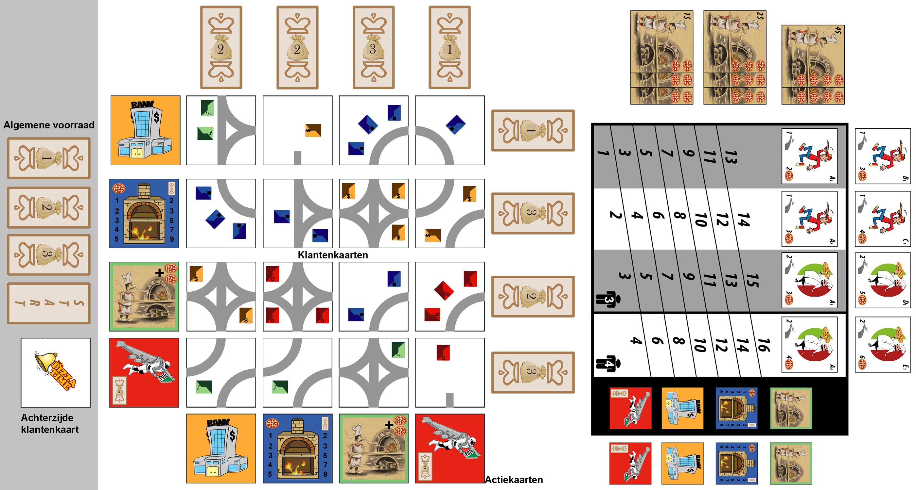
Setup?

Slide 4
Playing a round? (4 phases)
In turn order: put a worker on the gameboard and execute 1 action.
Receive bribes
Invest & deliver pizza’s.
Clean up en preparation for the next round.

Slide 5
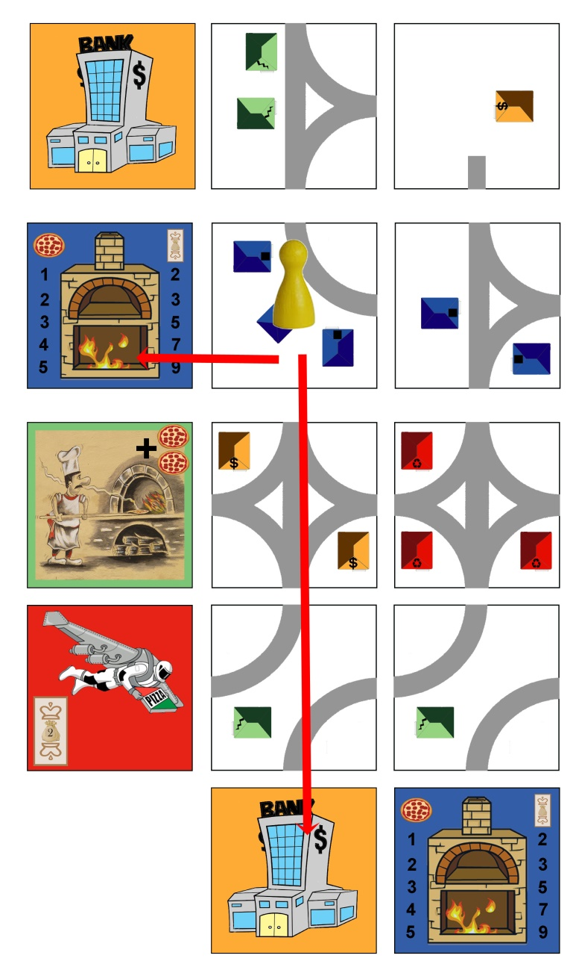
Phase 1: place workers on the gameboard and execute actions.
In turn order: replace one project from the gameboard with a worker.
Then choose either:
to build the project (=district) in your city
or
to discard the project and execute a special action
Ex: the yellow player chooses a project and puts his worker on the gameboard. Now he can build the project or discard the chosen project to execute the blue or yellow special action.

Slide 6
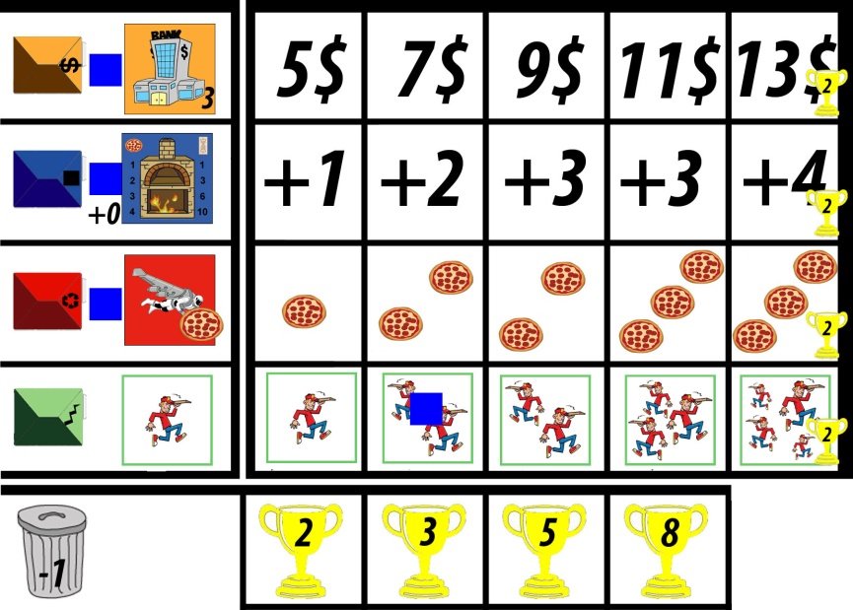
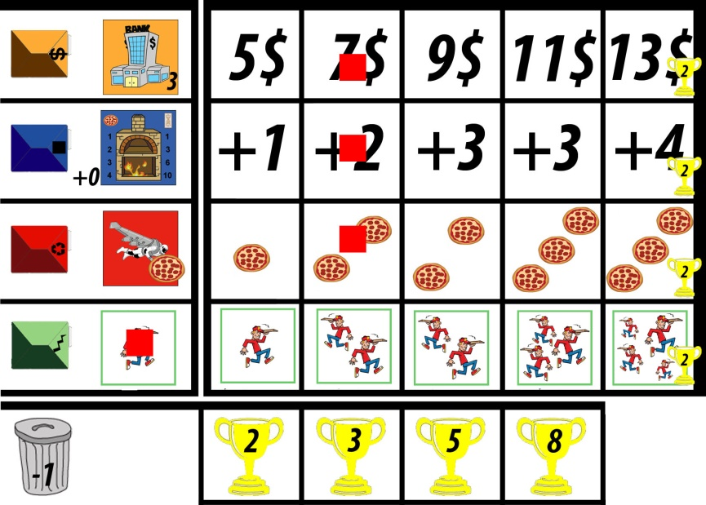
Special actions?
4 special actions: the more you advance on your playerboard, the more powerful they become!
You advance on your playerboard if you succefully provide districts with pizza’s or invest.
Ex:
Bake pizza’s (blue): blue pays 3 to bake 2 pizza’s (2+0). Red pays 3 to bake 4 (2+2)
Special delivery (red): blue can make one special delivery, red 2.
Take money: blue would receive 3$, red 7$
delivery directions: 2 for blue, 1 for red.

Slide 7
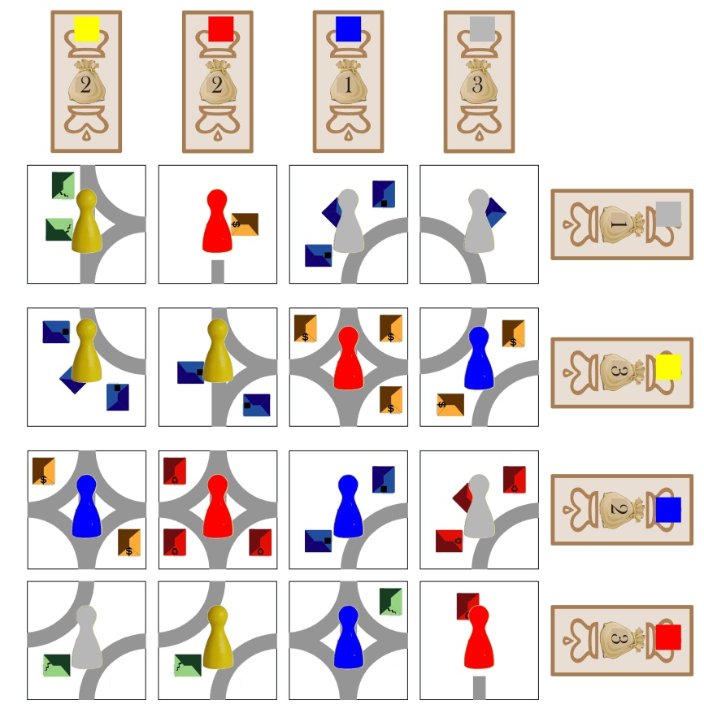
Phase 2: receive bribes
After each player placed 4 workers on the gameboard, the money on the gameboard is distributed. Check each row and column and give the money in that row/column to the player who has most workers in it. In case of a tie, the player whose worker is closest to the money receives it.
Ex: the situation at the end of the first phase. The money is distributed as shown by the cubes on it. In total yellow receives 5$, red 5$, blue 4$ and grey 2$

Slide 8
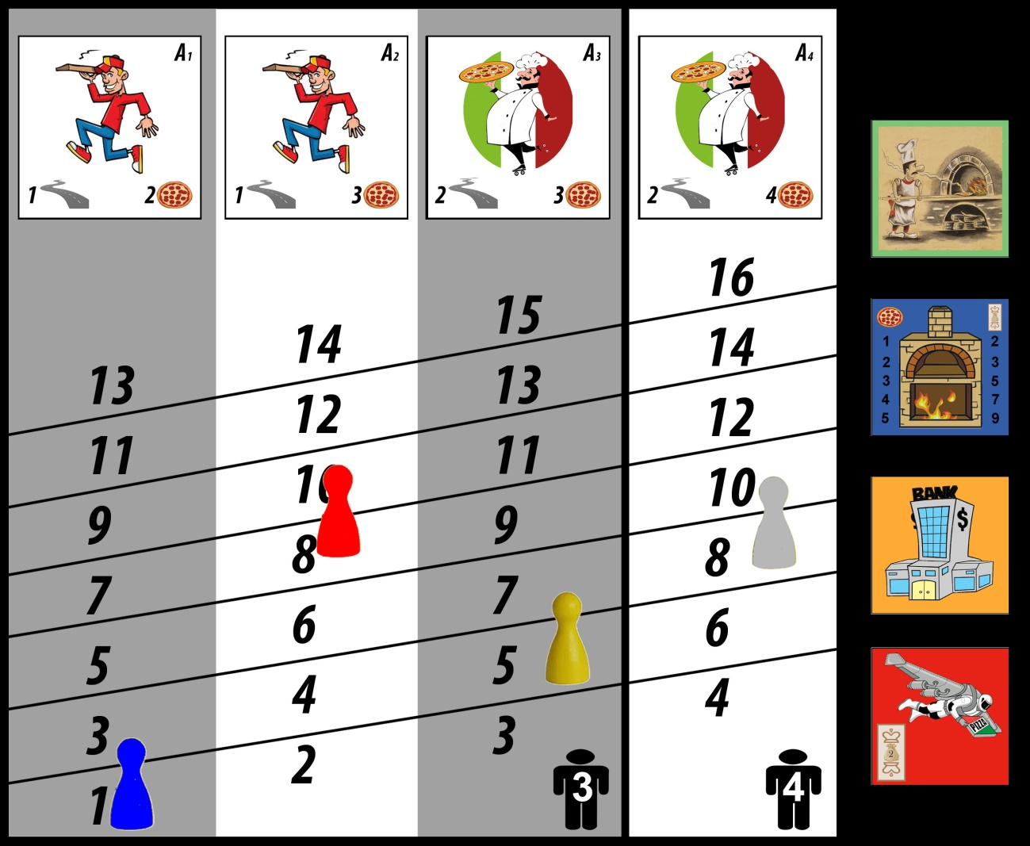
Phase 3: Invest and deliver
Bid to deliver and invest.
Worker highest on the bord invests first.
Worker with lowest bid, starts next round.
Each player receives delivery tile in same column as worker.

Slide 9
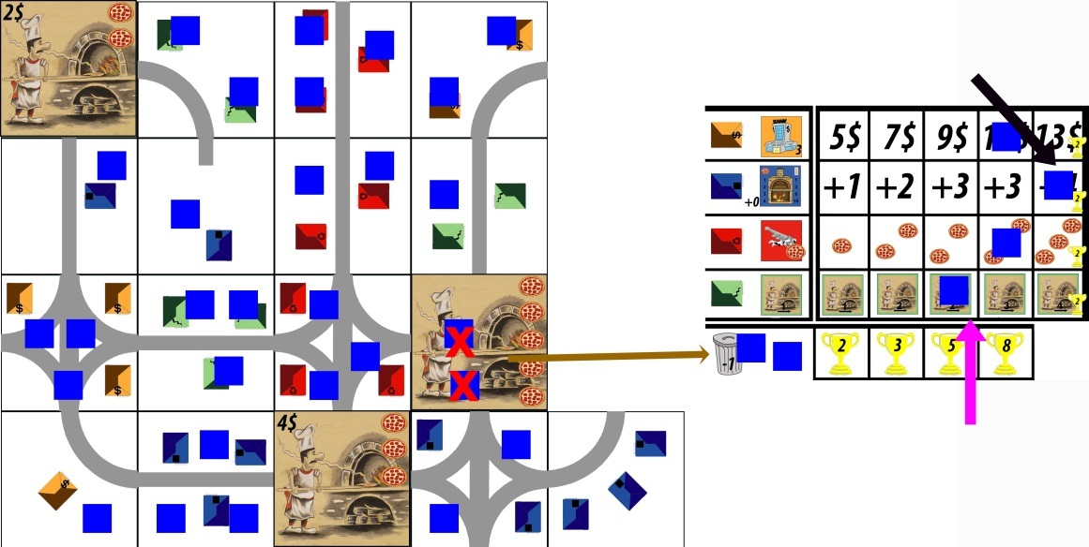
Final Scoring
After 5 rounds, each player evaluates his work.
Each undelivered pizza is put in the dustbin and counts -1 to your total.
Each delivered pizza is worth 1 point.
Add your bonus for expertise (progression cube on your playerboard)
Add your bonus for diversity (left most progression cube on your playerboard)
Blue removes 3 energy cubes from power plants (red crosses)
-1 for the lost energy cube (red arrow), place that energy cube next to you player board as a reminder.
+29 for the other energy cubes
+3 bonus for green buildings (black arrow)
+6 diversity bonus (purple arrow)
That makes a total of (-1+29+3+6=) 37 points.

Slide 10
Interested?
Questions, suggestions, feedback!
fabrice.vandenbogaerde@telenet.be or spellenclub13@telenet.be

